Slide 1
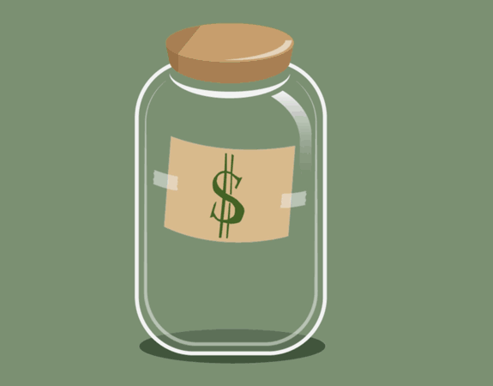
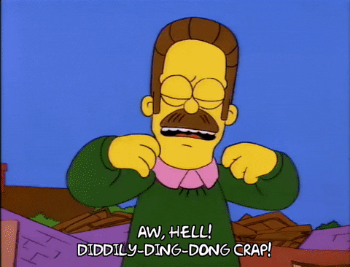
SwearJar Survey
Data 152 Project
Created by
Dylan Ray and Tyler Bontrager

Slide 2

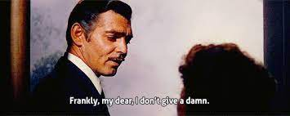
Swearing! It's all around us
Definition of a swear word: A profane or obscene oath or word
Swear words have been around for hundreds of years, the first one appearing in the 13th century, being the word “fart”
Swearing has been part of every aspect of life, from movies, music, books, and pretty any media where words are being said or being read
Fun Fact: Saying Damn in this movie, Gone With the Wind(1939), cost production $5000, or $108,574.10 in today's money

Slide 3
What is the Goal of the Study?
The goal of our study is to gauge Willamette’s casual language culture based on the responses from our survey.
Ultimately, we’d like to draw a quantified conclusion that may help put our findings into perspective

Slide 4
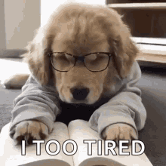
Type of Study and Response Variables
We conducted an observational study
Our response variables in this experiment are:
Age
Gender
Race
Origin
Major/Minor
Extracurricular activities
Favorite Swear Word
Most Used Swear Word
Age Started Swearing
Per Day Average of the five Most used Swear Words
Intensity of the five Most used Swear Word
Where are Most and Least Comfortable to Swear
Who do you Swear around the most
Where you have seen people swear the most
Who have you seen swear the most

Slide 5
Survey, More like Sur “YAY”
How was the study carried out: We created a survey on Google Form and asked people to fill it out
Observational Units: Students of Willamette who were willing to fill out the survey when we asked
Sample Size: 60 students filled out the survey

Slide 6
What is your Favourite Variable?
I’m not sure. It’s always changing
Examples of response variables: Swear word costs, frequency, intensity
Examples of covariates: Origin and Swearing frequency

Slide 7
That’s My Type, That’s My Type(Of Sampling Scheme)
-”My Type” by Saweetie
What Type of Sampling Scheme: Simple Random Sampling
How we limit bias in the survey: We limit bias in the survey by making sure that all of the questions were as vague and direct as possible, also making the survey anonymous so no one felt like their answer will connected to them

Slide 8
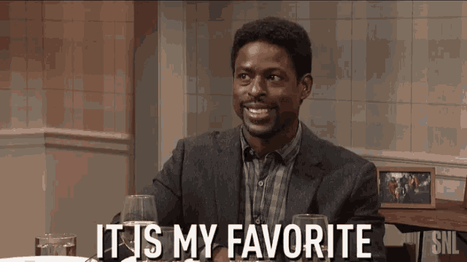
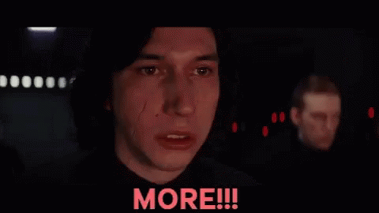
Difference Between “Favorite” vs “Most Used” Swear Word
Favorite:
Swear words that you would like to say; you just like word and how it rolls off your tongue
Most Used:
Swear words you use most often in everyday conversation

Slide 9
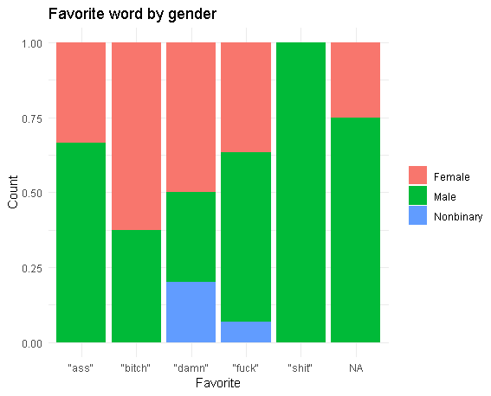
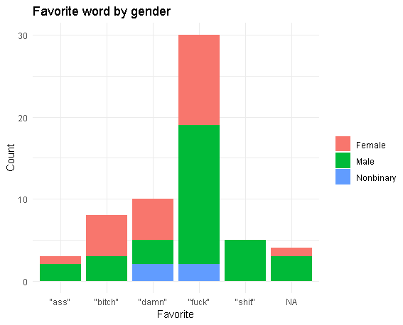
Favorite Swear Word Based on Gender

Slide 10
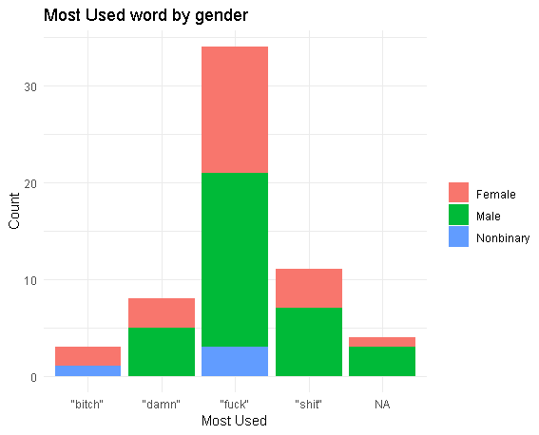
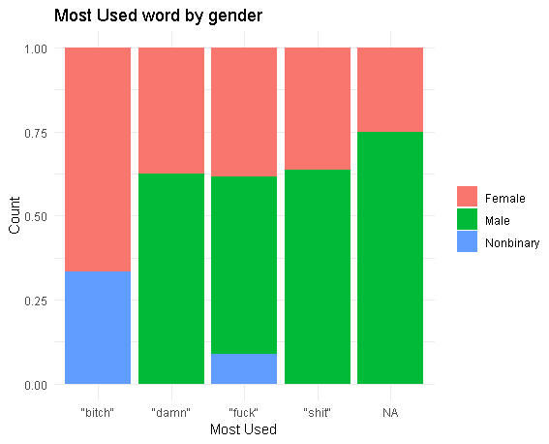
Most Used Swear Word Based On Gender

Slide 11
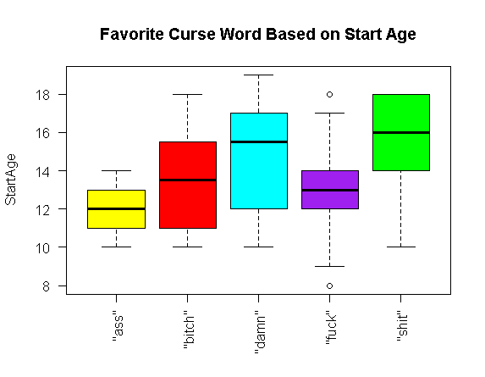
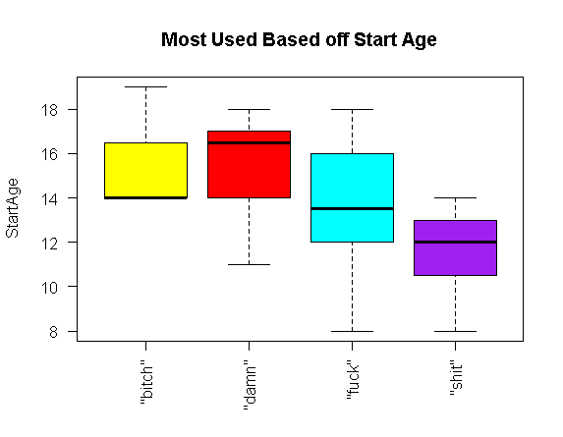
Favorite Curse vs Most Used Word Based On Start Age

Slide 12
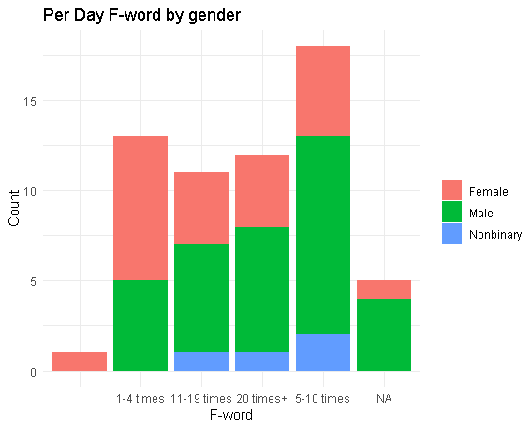
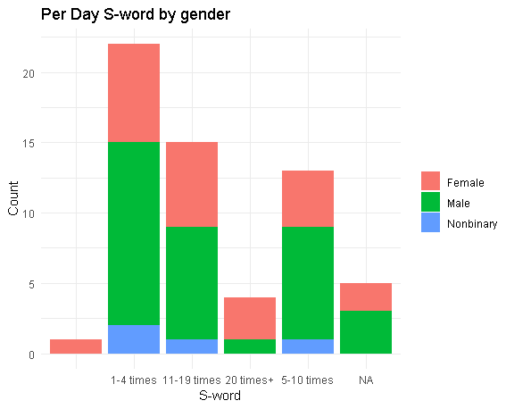
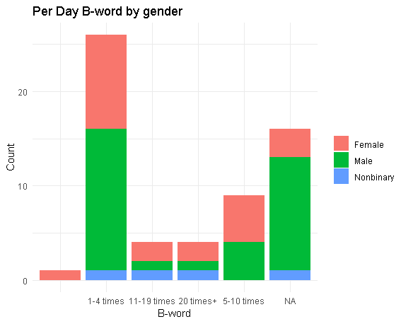
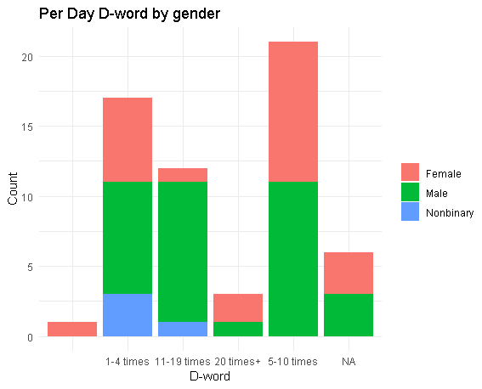
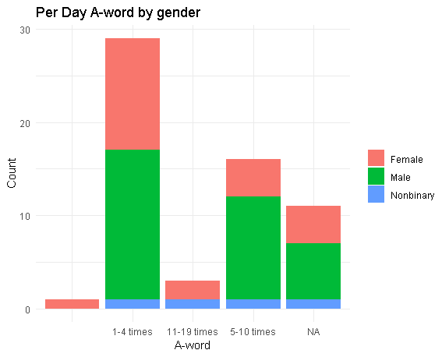
Per Day by Gender

Slide 13
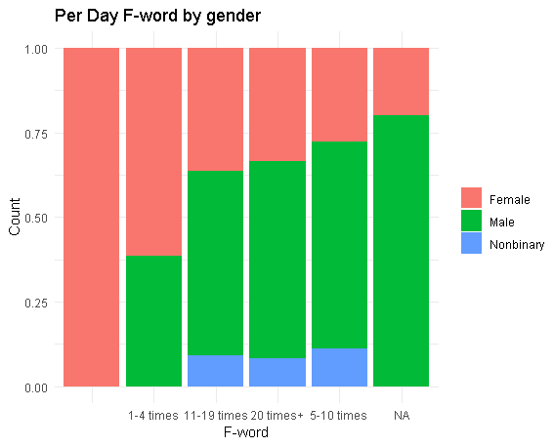
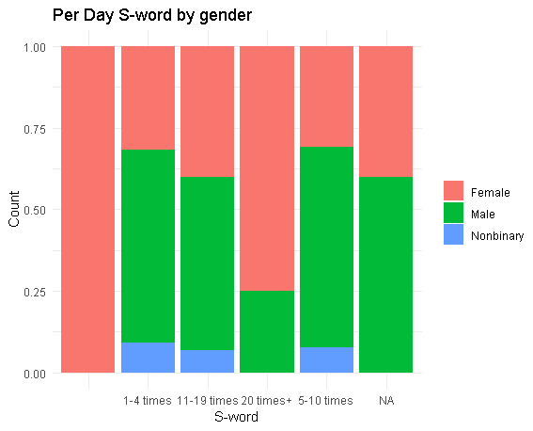
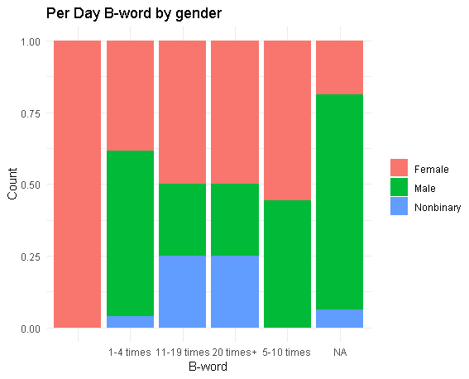
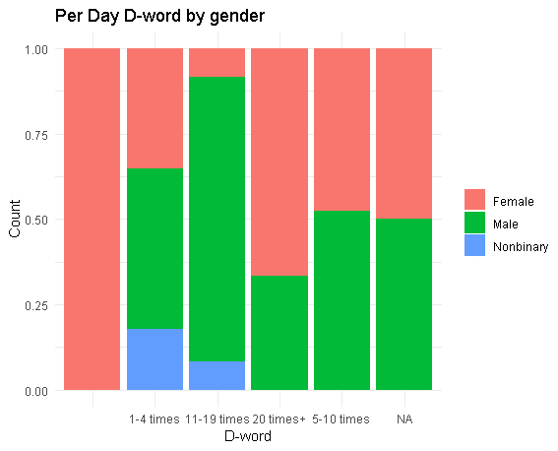
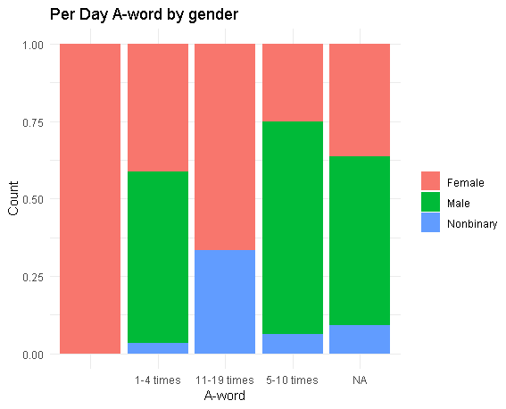
Per Day by Gender(Proportion)

Slide 14
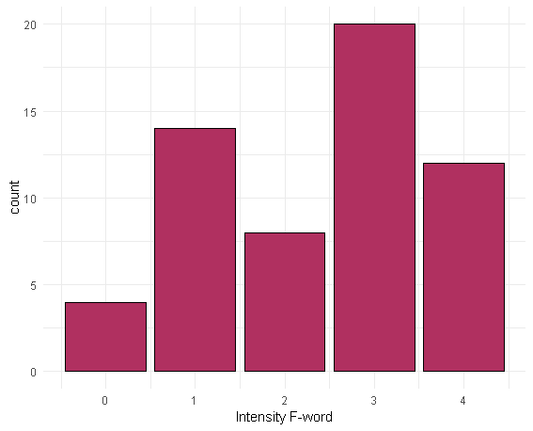
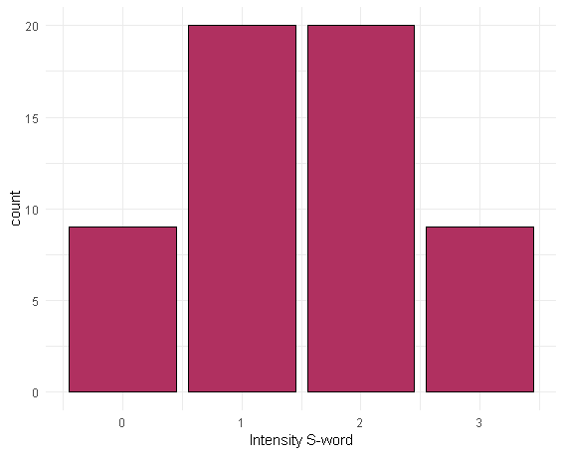
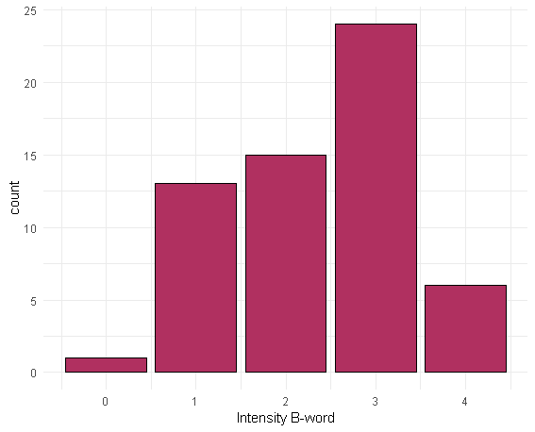
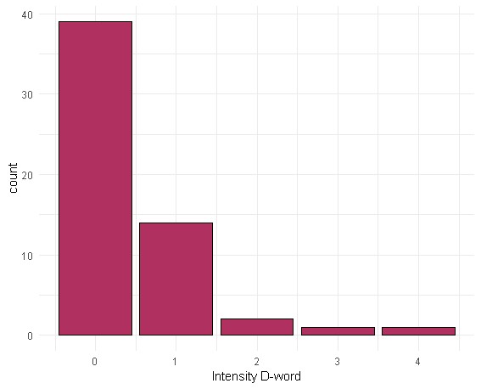
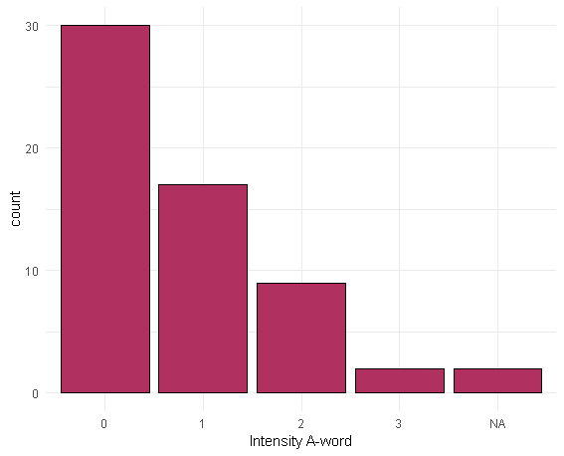
Intensity by Word

Slide 15
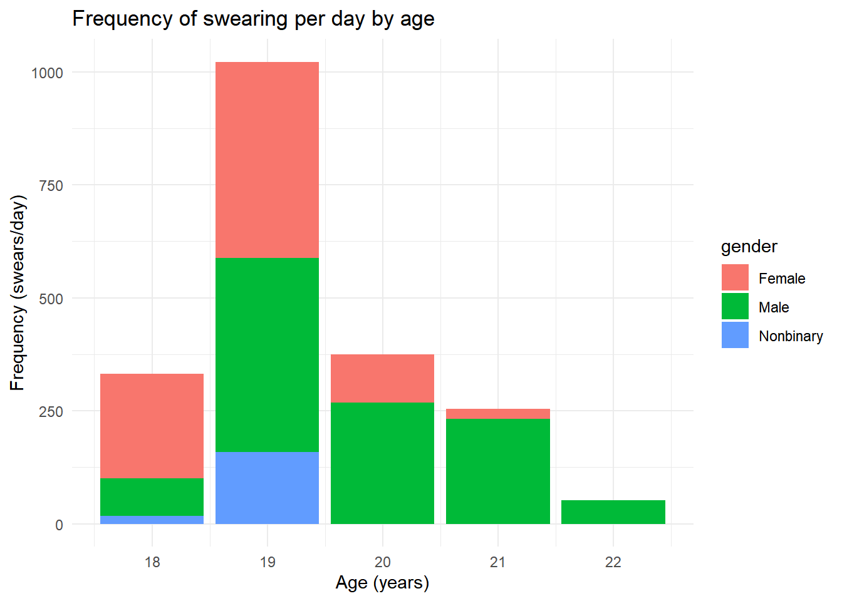
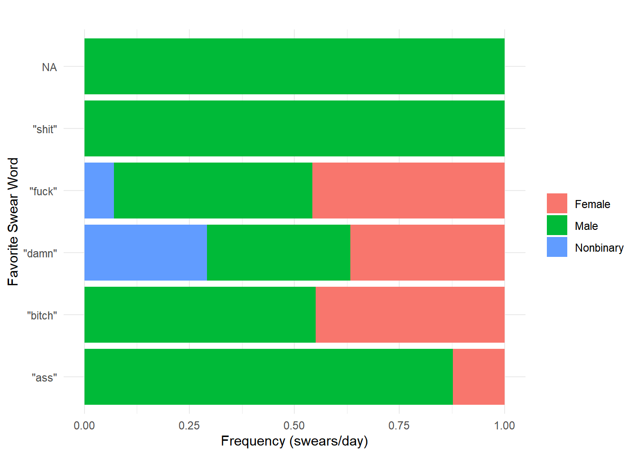

Slide 16
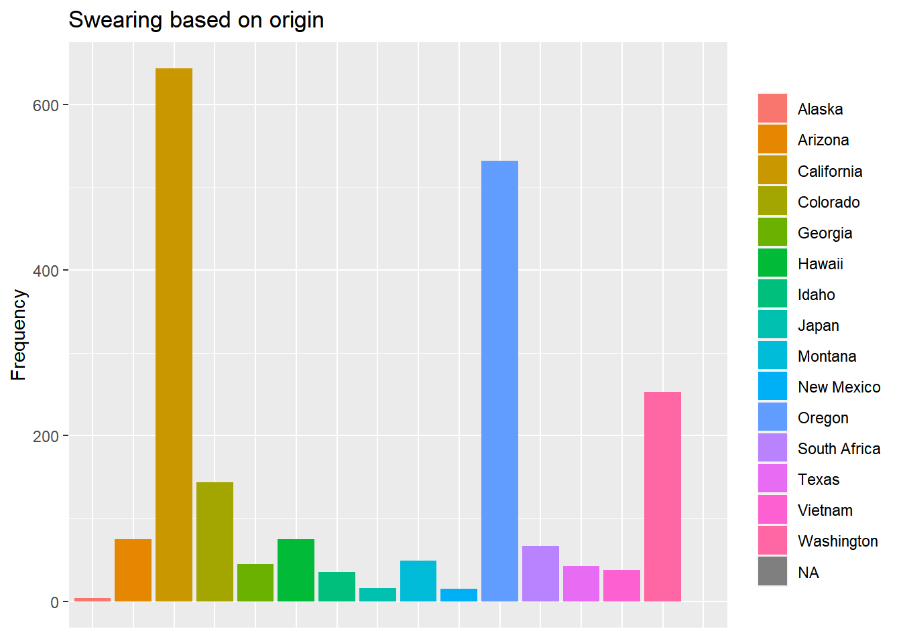

Slide 17
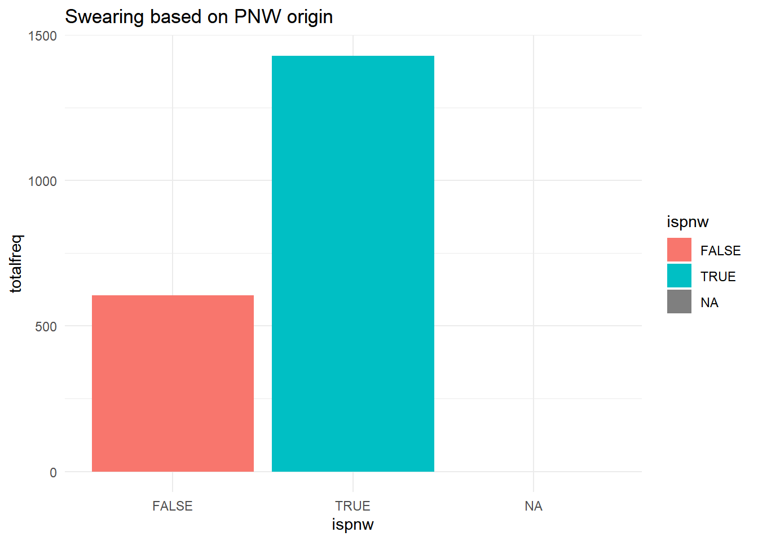
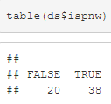

Slide 18
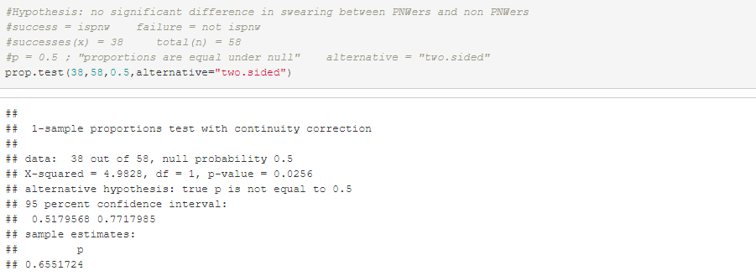
Conclusion:
There is enough evidence to reject the hypothesis that
there is an equal proportion of people who swear if they're from the PNW or not.
People from the PNW have more tendency to swear than those not from the PNW
Assumptions:
Independent, normally distributed if arranged, but perhaps not a great representative sample.

Slide 19
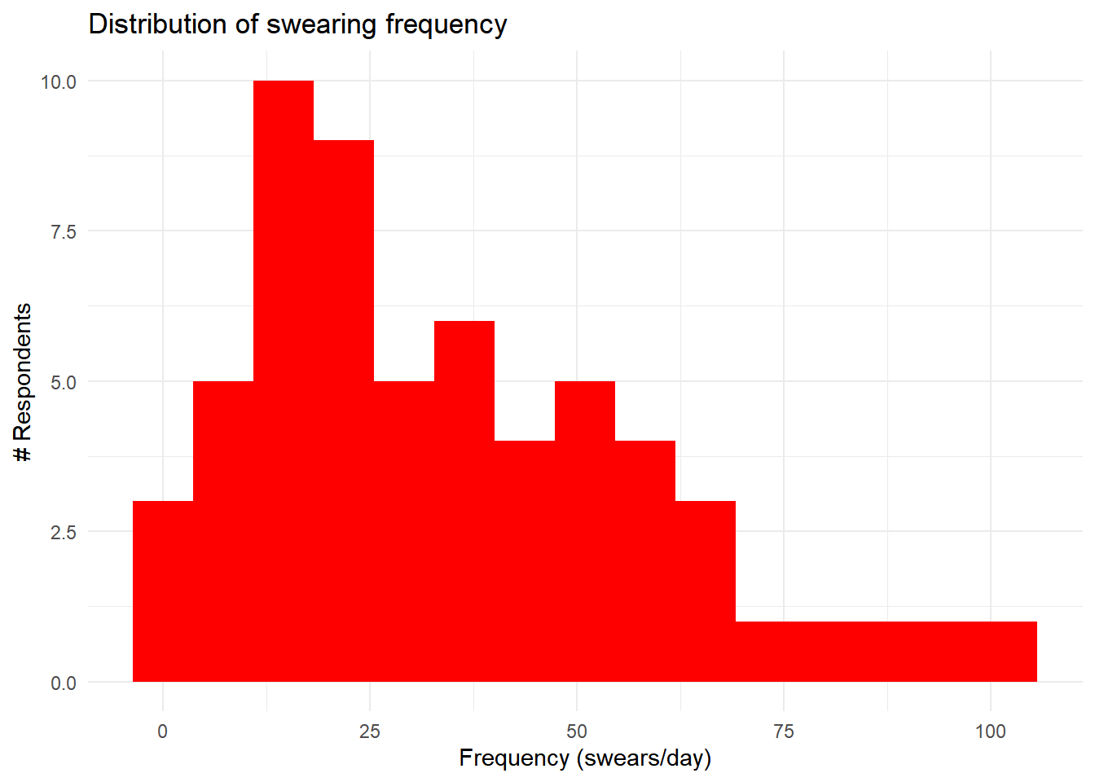

Slide 20
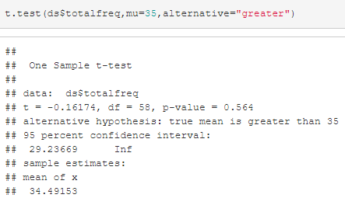
Is the true mean of swearing frequency greater than what is visualized?
Null: the true mean is ~35 swears per day
Alternative: WU students are
pottymouths

Slide 21
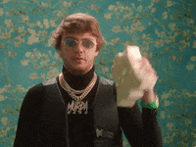
#As it turns out, it seems 35 is pretty close to the true mean.
#Assumptions: Independent obs, representative sample, normal distribution!
#Independence: How often one person swears doesn't affect how often another person swears.
# P(one person swearing 25 times) * P(one person swearing 10 times) =
# P(one person swearing 25 times and one person swearing 10 times)
#Next step is assume each person at WU swears an average of 35 times for an average of a level-2 intensity word. Average cost per swear is $0.29. 35 swears per day implies average swear cost per student is
#$10.15 * 1367 students (Source: About Willamette 2022)
means that $13,875.05 is owed to the Willamette swear jar.
#Means of cost to use each swear word
#F:0.602 S:0.398 D:0.150 B:0.606 A:0.214

Slide 22
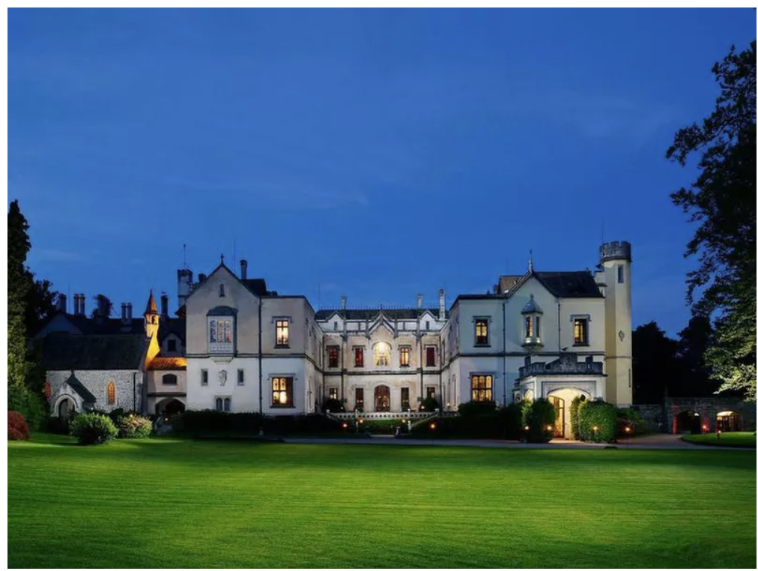
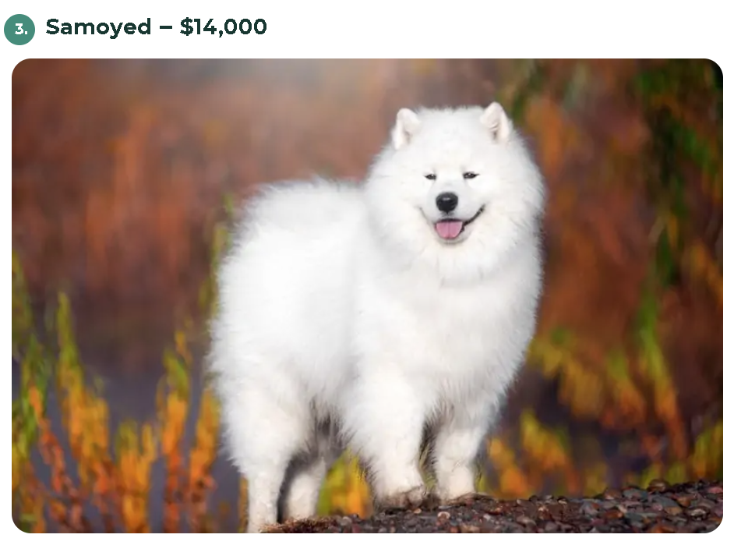
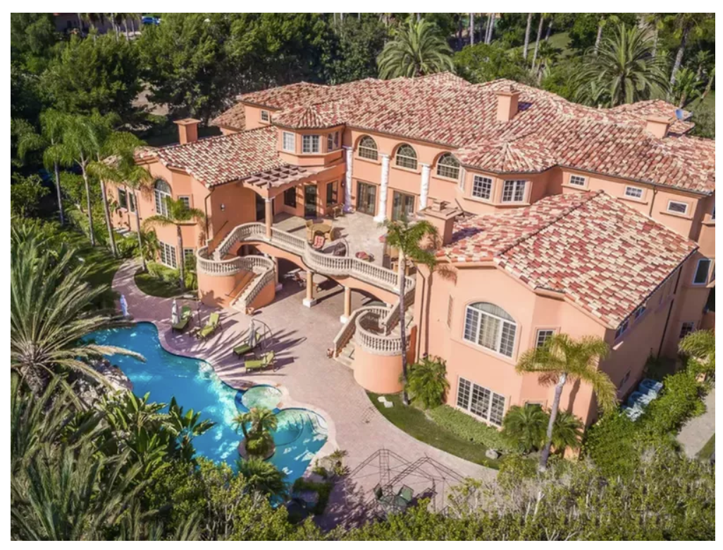
Things you can buy for $14,000
Rent this mansion for 5 days
Rent this castle for 10 days
Buy this dog

Slide 23
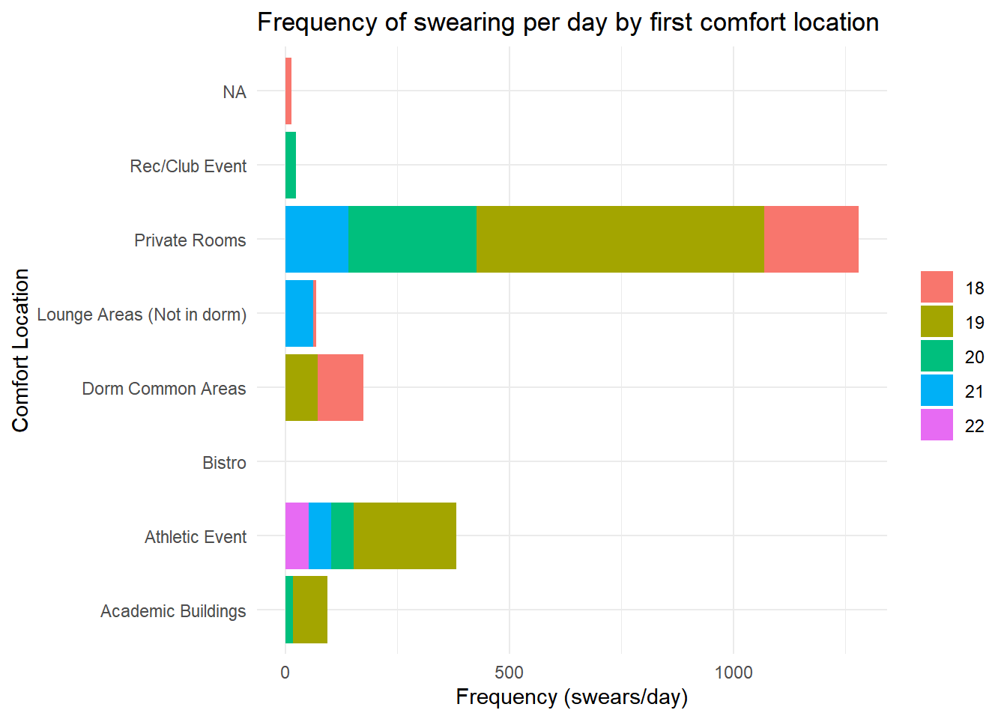
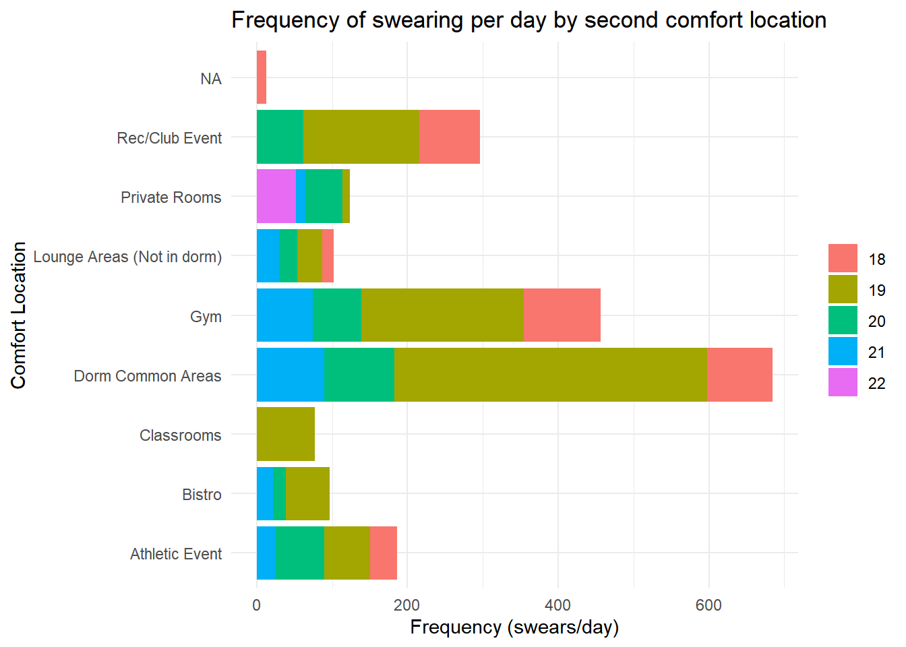

Slide 24
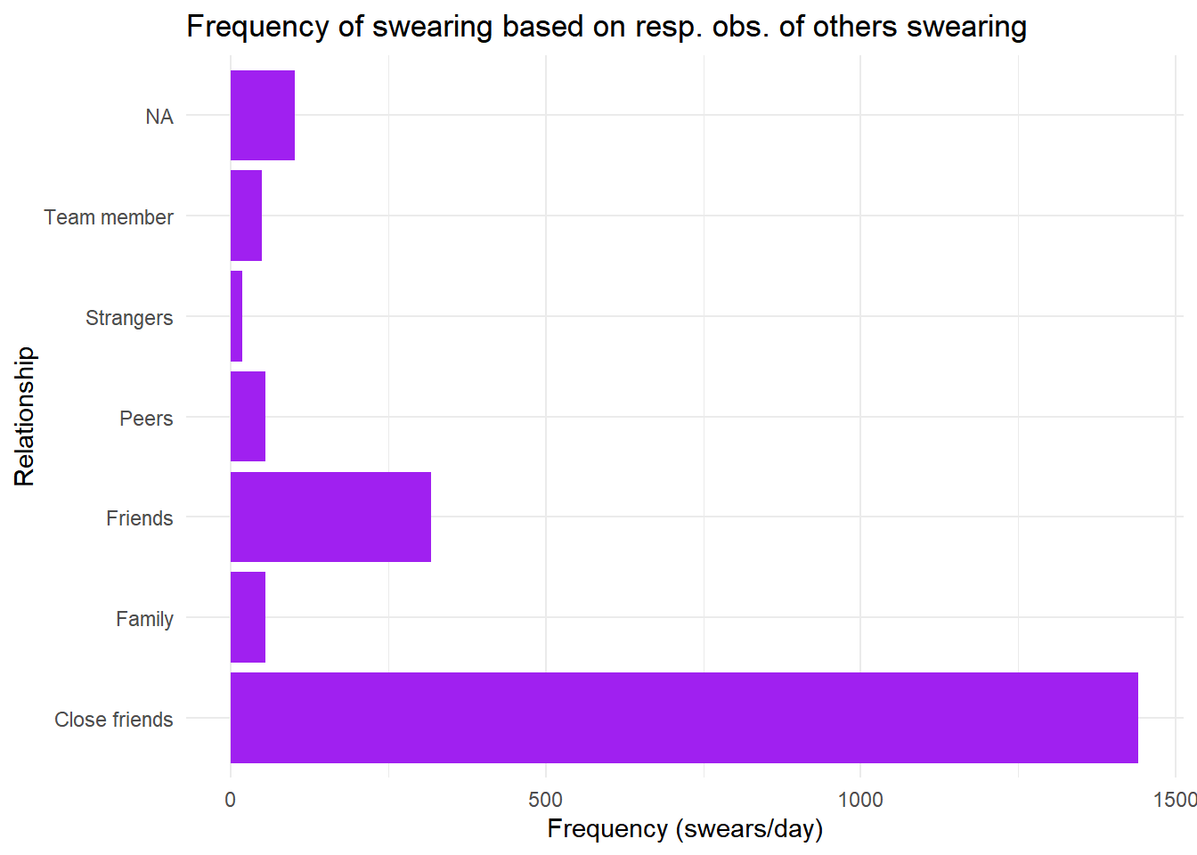

Slide 25
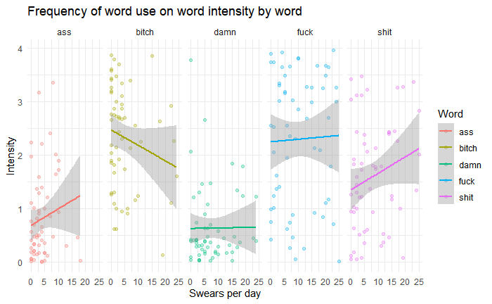

Slide 26
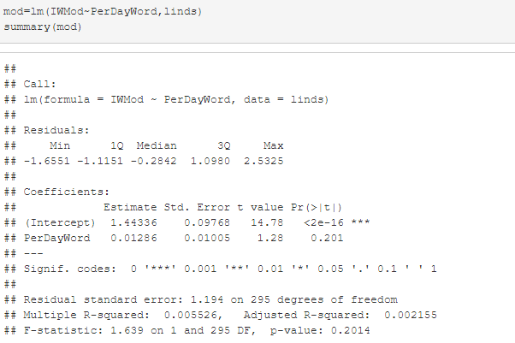
Highlights:
Limited sample size and metrics do not lend themselves well to a good model.
Generally speaking, intensity seems to be justified by word frequency
Friends comfortable with swearing next to each other tends to have a positive feedback phenomenon on frequency

Slide 27
“Although We Come, To the End of the Road”
- Boyz II Men (Conclusion)
Main Takeaways:
Majority of people favorite and most used was the f-word
Gender does not play a factor in Fav. or most used swear word
The more intense a person thought a swear word was, they are likely not to say as often during the day
Limitations:
Our sample size was very small, so the graphs and other means do not represent Willamette as a whole
Based on the limited number of people asked, we do not know if origin has a effect on swear words
Didn’t ask people for their specific favorite swear word variation.
Future Step of Analysis
Ask more people to take the survey
Put more specific question in the survey to allow to more direct answers

Slide 28
TOTAL AMOUNT OWED
$13,875.05

